Slide 2
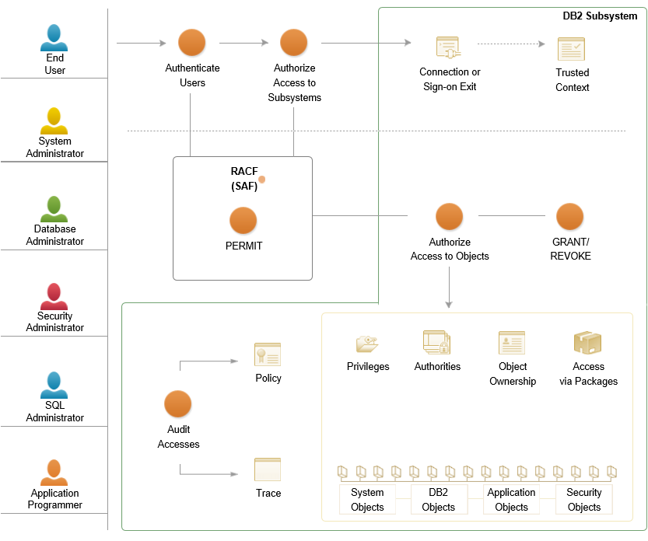
DB2 Security
2
Courtesy IBM Knowledge center

Slide 3
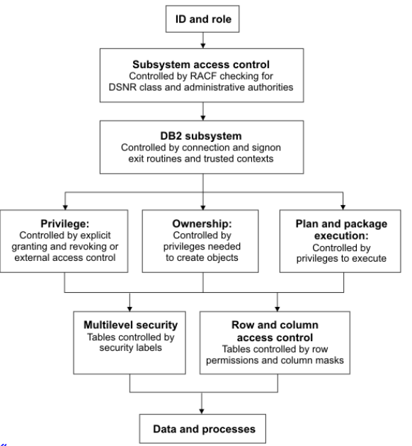
Managing access through AUTH IDs and roles
3
Courtesy IBM Knowledge center

Slide 4
New granular system authorities
Prior to DB2 10
SYSADM
DBADM
DBCTRL
DBMAINT
SYSCTRL
PACKADM
SYSOPR
New in DB2 10
System DBADM
ACCESSCTRL DATAACCESS
SECADM
SQLADM
EXPLAIN
4

Slide 5
SECADM
The SECADM authority enables to manage security-related objects in DB2® and control access to all database resources. It does not have any inherent privilege to access data stored in the objects, such as tables
During DB2 V10 installation in Protection panel 2: DSNTIPP1:
If the SEPARATE_SECURITY system parameter is set to YES, no other authority can grant the ACCESSCTRL, System DBADM, and DATAACCESS authorities or the CREATE_SECURE_OBJECT privilege, not even SYSADM. For example, only SECADM, not SYSADM or DBADM, can activate or deactivate row or column access control for a table
5
Notes:
How many of you are involved in Installing DB2 V10 ? Can you provide insights on this ?
5

Slide 6
With SECADM authority:
Create, alter, drop, and comment on row permissions
Create, alter, drop, and comment on column masks
Activate and deactivate row access control
Activate and deactivate column access control
Create, drop, and comment on roles
Create, alter, drop, and comment on trusted contexts
Create and comment on secure triggers and user-defined functions
Alter the SECURED or NOT SECURED clause on triggers and user-defined functions
6
Notes:
When GROUPID is given SECADM. The USERID does not have the access TO SECADM
DSNT408I SQLCODE = -552, ERROR: UserID DOES NOT HAVE THE PRIVILEGE TO PERFORM OPERATION CREATE CONTEXT
6

Slide 7
With SECADM authority:
Create audit policies by inserting rows into the SYSIBM.SYSAUDITPOLICIES catalog table
Access and update the SYSIBM.SYSAUDITPOLICIES catalog table which records audit policy definitions
Has implicit SELECT access on all catalog tables and implicit INSERT, DELETE, and UPDATE privileges on updatable catalog tables
Grant and revoke all grantable privileges and authorities
Issue the TRACE command to start, stop, and display a trace
7

Slide 8
New System Privileges
ACCESSCTRL
Grants the ACCESSCTRL authority. ACCESSCTRL allows the user to grant all authorities and privileges, except system DBADM, DATAACCESS, ACCESSCTRL, and privileges on security related objects. A warning is issued if the WITH GRANT OPTION is specified when granting this authority. ACCESSCTRL cannot be granted to PUBLIC.
CREATE_SECURE_OBJECT
Grants the privilege to create a secure object.
DATAACCESS
Grants the DATAACCESS authority. DATAACCESS allows the user to access data in all user tables, views, and materialized query tables in a DB2 subsystem and allows the user to execute plans, packages, functions, and procedures. A warning is issued if the WITH GRANT OPTION is specified when granting this authority.
DATAACCESS cannot be granted to PUBLIC.
8

Slide 9
New System Privileges
DBADM
Grants the DBADM authority. DBADM allows the user to manage all objects in the DB2 subsystem, except security objects. A warning is issued if the WITH GRANT OPTION is specified when granting this authority. DBADM cannot be granted to PUBLIC.
WITH ACCESSCTRL
Specifies that the ACCESSCTRL authority is granted along with the system DBADM authority. ACCESSCTRL allows system DBADM to grant all authorities and privileges, except system DBADM, DATAACCESS, ACCESSCTRL authorities and privileges on security related objects. ACCESSCTRL can be used to REVOKE privileges using the BY clause.
WITH ACCESSCTRL is the default.
9

Slide 10
New System Privileges - DBADM
WITHOUT ACCESSCTRL
Specifies that system DBADM authority is not granted the ACCESSCTRL authority.
WITH DATAACCESS
Specifies that the DATAACCESS authority is granted along with the system DBADM authority. DATAACCESS allows the system DBADM to access data in all user tables, views, and materialized query tables in a DB2 subsystem and allows the user to execute plans, packages, functions, and procedures.
WITH DATAACCESS is the default.
WITHOUT DATAACCESS
Specifies that system DBADM authority is not granted the DATAACCESS authority.
10

Slide 11
New System Privileges
EXPLAIN
Grants the privilege to issue the following without requiring the privileges needed to execute the statement:
EXPLAIN statement with the options:
PLAN
ALL
PREPARE statement
DESCRIBE TABLE statement
Explain dynamic SQL statements that execute under the special register CURRENT EXPLAIN MODE, when CURRENT EXPLAIN MODE = EXPLAIN
BIND options: EXPLAIN(ONLY) and SQLERROR(CHECK)EXPLAIN(ONLY) allows to explain the statements.
SQLERROR(CHECK) performs all syntax and semantic checks on the SQL statements that are being bound.
11

Slide 12
New System Privileges
SQLADM
Grants the authority to perform the following actions without requiring any additional privileges:
DESCRIBE TABLE statement
EXPLAIN statement with the following options:
PLAN
ALL
STMTCACHE ALL
STMTID
STMTTOKEN
MONITORED STMTS
PREPARE statement
Explain dynamic SQL statements that execute under the special register CURRENT EXPLAIN MODE, when CURRENT EXPLAIN MODE = EXPLAIN
12

Slide 13
New System Privileges - SQLADM
BIND options:
EXPLAIN(ONLY) allows to explain the statements.
SQLERROR(CHECK) performs all syntax and semantic checks on the SQL statements that are being bound.
START command
STOP command
DISPLAY PROFILE command
Execute the RUNSTATS utility and the MODIFY STATISTICS utility in any database.
MONITOR2 privilege to obtain IFC data classified as containing potentially sensitive data, such as SQL statement text and audit data, as well as IFC data classified as serviceability data, statistics, accounting, and other performance data.
13

Slide 14
Role & Trusted CONTEXT:
A role is a database entity that groups one or more privileges together in a trusted context. System administrators can use roles to control access to enterprise objects in a way that parallels the structure of the enterprise.
A role is available only in a trusted context.
A trusted context is an independent database entity that can be defined based on a system authorization ID and connection trust attributes. The trust attributes specify a set of characteristics about a specific connection. These attributes include the IP address, domain name, or SERVAUTH security zone name of a remote client and the job or task name of a local client.
An authorization ID can have only one role in a trusted context at any given time
14

Slide 15
Role & Trusted CONTEXT:
CREATE ROLE rolename ;
For Remote Trusted connection :
CREATE TRUSTED CONTEXT CTX1
BASED UPON CONNECTION USING
SYSTEM AUTHID Authid1
ATTRIBUTES
(ADDRESS ‘n.nn.nn.nnn.nnn', ENCRYPTION 'LOW')
DEFAULT ROLE CTXROLE
ENABLE
WITH USE FOR UID1, UID2 ROLE ROLE1
WITH AUTHENTICATION;
15
Notes:
First one is for remote connection
Second one is when defining trusted context locally within mainframe.
WITH AUTHENTICATION, WITHOUT AUTHENTICATION etc.
The newly created trusted context takes effect after the CREATE TRUSTED CONTEXT statement is committed. If the CREATE TRUSTED CONTEXT statement results in an error or is rolled back, no trusted context is created.
The system AUTHID is the primary AUTHID used to establish the trusted connection.
Remote connection trust attributes: –SYSTEM AUTHID –ADDRESS –SERVAUTH –ENCRYPTION
Local connection trust attributes: –SYSTEM AUTHID –JOBNAME
15

Slide 16
Local Trusted CONTEXT:
CREATE TRUSTED CONTEXT CTX2
BASED UPON CONNECTION USING
SYSTEM AUTHID Authid2
ATTRIBUTES
(JOBNAME ‘TSOID')
DEFAULT ROLE CTXROLE
WITH ROLE AS OBJECT OWNER AND QUALIFIER
ENABLE
WITH USE FOR UID3;
16
Notes:
First one is for remote connection
Second one is when defining trusted context locally within mainframe.
WITH AUTHENTICATION, WITHOUT AUTHENTICATION etc.
The newly created trusted context takes effect after the CREATE TRUSTED CONTEXT statement is committed. If the CREATE TRUSTED CONTEXT statement results in an error or is rolled back, no trusted context is created.
The system AUTHID is the primary AUTHID used to establish the trusted connection.
Remote connection trust attributes: –SYSTEM AUTHID –ADDRESS –SERVAUTH –ENCRYPTION
Local connection trust attributes: –SYSTEM AUTHID –JOBNAME
16

Slide 17
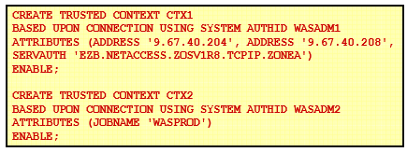
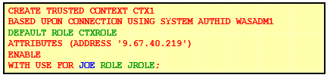
Create Trusted CONTEXT Examples:
17
Notes:
First one is for remote connection
Second one is when defining trusted context locally within mainframe.
WITH AUTHENTICATION, WITHOUT AUTHENTICATION etc.
The newly created trusted context takes effect after the CREATE TRUSTED CONTEXT statement is committed. If the CREATE TRUSTED CONTEXT statement results in an error or is rolled back, no trusted context is created.
The system AUTHID is the primary AUTHID used to establish the trusted connection.
Remote connection trust attributes: –SYSTEM AUTHID –ADDRESS –SERVAUTH –ENCRYPTION
Local connection trust attributes: –SYSTEM AUTHID –JOBNAME
17

Slide 18
New Functions
VERIFY_GROUP_FOR_USER
VERIFY_ROLE_FOR_USER
VERIFY_TRUSTED_CONTEXT_ROLE_FOR_USER
SESSION_USER or USER Specifies the value of the SESSION_USER (or USER) special register.
18
Notes:
18

Slide 19
Verifying the USERID / ROLE
SELECT SESSION_USER
FROM SYSIBM.SYSDUMMY1
;
SELECT ‘Indicator'
FROM SYSIBM.SYSDUMMY1
WHERE
VERIFY_TRUSTED_CONTEXT_ROLE_FOR_USER
(SESSION_USER,‘Rolename') = 1 ;
19

Slide 20
DROP ROLE rolename
When a role is dropped, all privileges and authorities that have been previously granted to that role are revoked. If the role that is dropped is the owner of statements in the dynamic statement cache, the cached statements are invalidated.
The role is not dropped if any REVOKE restrictions are encountered. REVOKE restrictions include the following:
Restrictions that are encountered when dependent privileges are included when the privileges of a role are revoked.
The role is the grantor of any privilege or authority that used ACCESSCTRL or SECADM authority to perform the grant.
20
Notes:
20

Slide 21
DROP ROLE Contd…
If RESTRICT is specified, the role is not dropped is any of the following dependencies exist:
The role is associated with any trusted context or any user in a trusted context.
The role is associated with a currently running thread.
The role is the owner of any of the following objects:
Alias , Column mask , Database , Distinct type , Index ,
JAR file, Materialized query table , Package , Role ,
Row permission , Sequence, Storage group,
Stored procedure, Table, Table space , Trigger,
Trusted context , User-defined function, View
21

Slide 22
DROP Trusted CONTEXT
When a trusted context is dropped, all associations to attributes (IP addresses, job names) and associations to users of the trusted context are dropped.
If the trusted context is dropped while trusted connections for the context are active, the connections remain active until they terminate or the next attempt at reuse is made.
22

